Slide 1
Pulse Check Decisions

Slide 2
Scenario
You respond to a code blue on E50 and upon arrival you see a nurse performing chest compressions on a patient in bed
You establish yourself as the code leader while the rest of the team arrives
What are your next steps?

Slide 3
At first Pulse Check…
No pulse
Notes:
Fine vfib, shock

Slide 4
After resuming CPR
Nurse tells you she is having difficulty feeling a pulse even during compressions
How else can we detect ROSC?

Slide 5
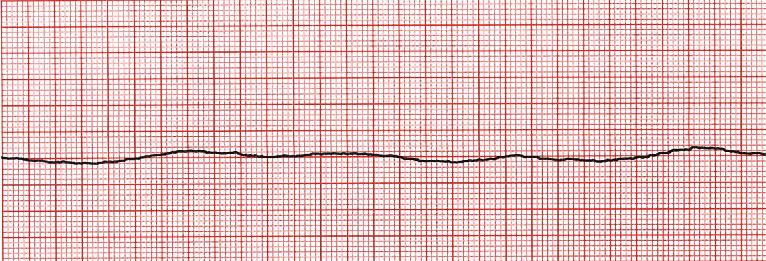
At next pulse check…
No pulse
Just prior to resuming compressions, anesthesia is ready to intubate but asks for a bit more time
Thoughts?

Slide 6
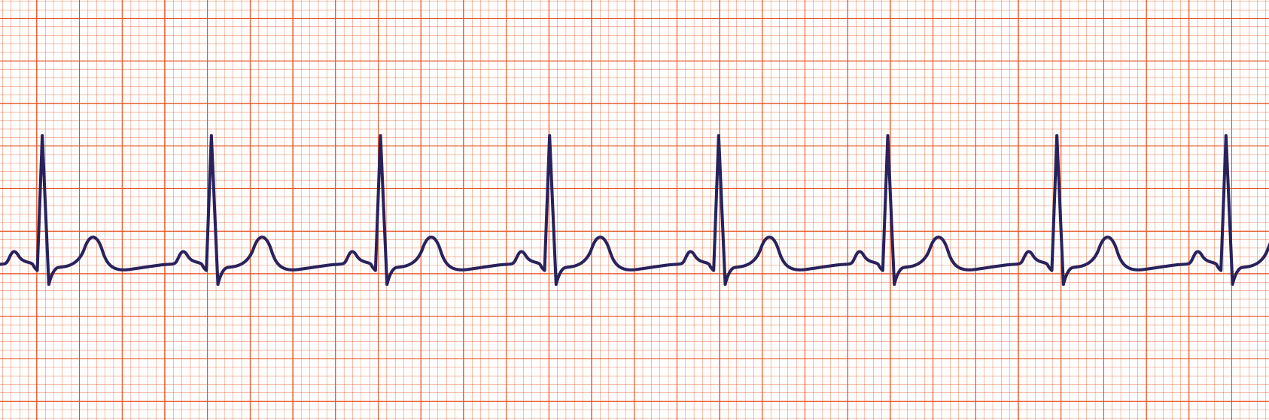
At next pulse check
ETCO2 = 36

Slide 7
The consequences of errors:
Your Decision
 | You defibrillate | You don’t
They have VF or VT* | 👍👍 | 👎👎👎👎👎👎👎👎👎👎👎👎👎👎👎👎
They have PEA/Asystole | 👎 | 👍👍
Reality
(unknown)
Therefore:
You(r team) must identify actionable rhythms correctly
When unsure, make the better error
Notes:
* The same is true for other rhythms e.g. complete heart block or Afib vs NSR, but answers aren’t needed as fast and consequences aren’t severe.

Slide 8
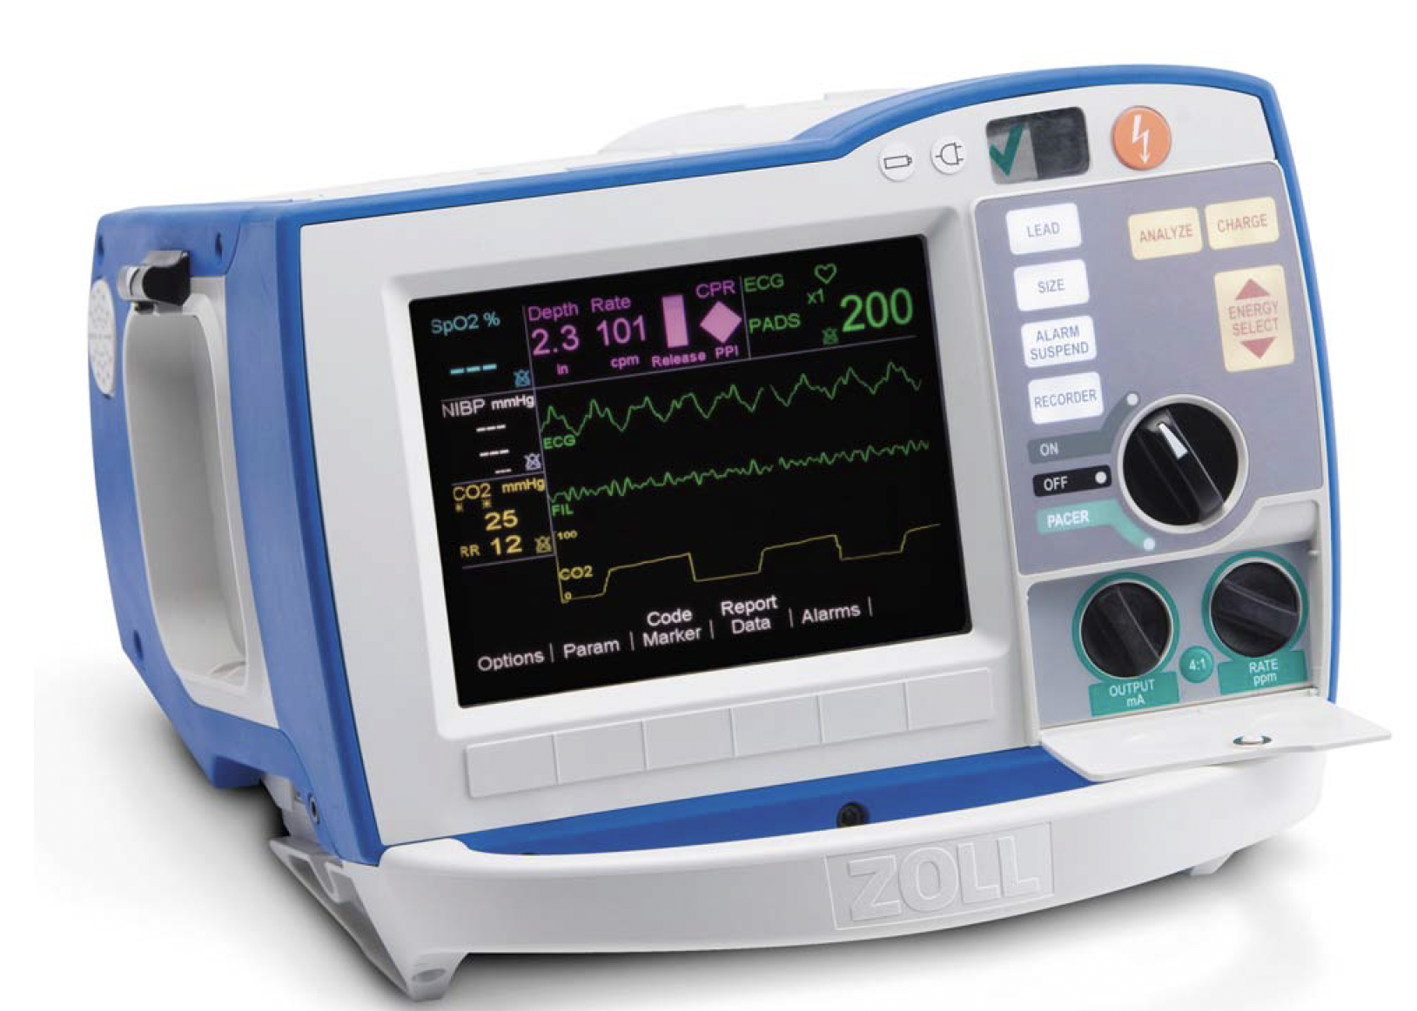
What can you do when you’re unsure?
Make the better error
Enroll help (the nurses are good)
“Are we certain this is asystole?"
Turn up the gain

Slide 9
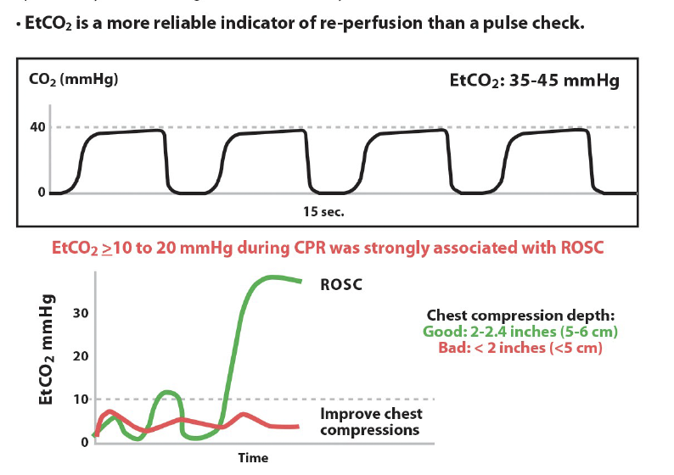

What if the pulse is hard to feel?
10 second pause, total
Use doppler
Use EtCO2 to help detect ROSC

Slide 10
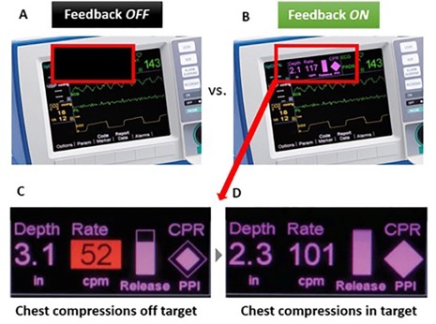
What is the big picture?
If they don’t have a pulse, someone is compressing the chest with high quality CPR. NO significant breaks.
Minimize pauses to necessary position changes, pulse checks, and a little wiggle room to the Lucas or intubation (but only a little)
Shock them if they have a shockable rhythm
The rest (mostly*) not so important
Notes:
Survival from witnessed ventricular fibrillation (VF) decreases by 10–12% for every minute defibrillation is delayed [3, 4], but when CPR is provided the decline in survival is only 3-4% per minute
Utilize code team members – 1 to check pulse and 1 to monitor tele/zoll monitor
Spend only 10 seconds checking for a pulse to minimize interruptions in CPR
You don’t want house md at your code. Don’t try to diagnose lupus in a code.
The rest is whatever (people will be fired up about all sorts of things, but they don't matter). It’s a bonus if you figure out why they coded, but it’s a small, small minority where the etiology is not blindingly obvious but is also easily reversible.
LUCAS: institution policies vary, but
Negative RCT in OHCA - DOI:https://doi.org/10.1016/S0140-6736(14)61886-9
Negative retrospective data in IHCA - https://doi.org/10.1016/j.resuscitation.2024.110142
The only time it may be important is ECMO/long resusc with procedure.
IF pause in compression is more than a few seconds, USE YOUR CRED HERE.

Slide 11
Summary: Pulse Check Decisions
Codes are uncertain: if you might make an error, make the better one.
DO NOT MISS FINE V. Fib
Only allow, at most, a few seconds of CPR delay for Lucas / Intubation
This is a decision to spend your “political capital” on
Use EtCO2

